Slide 1
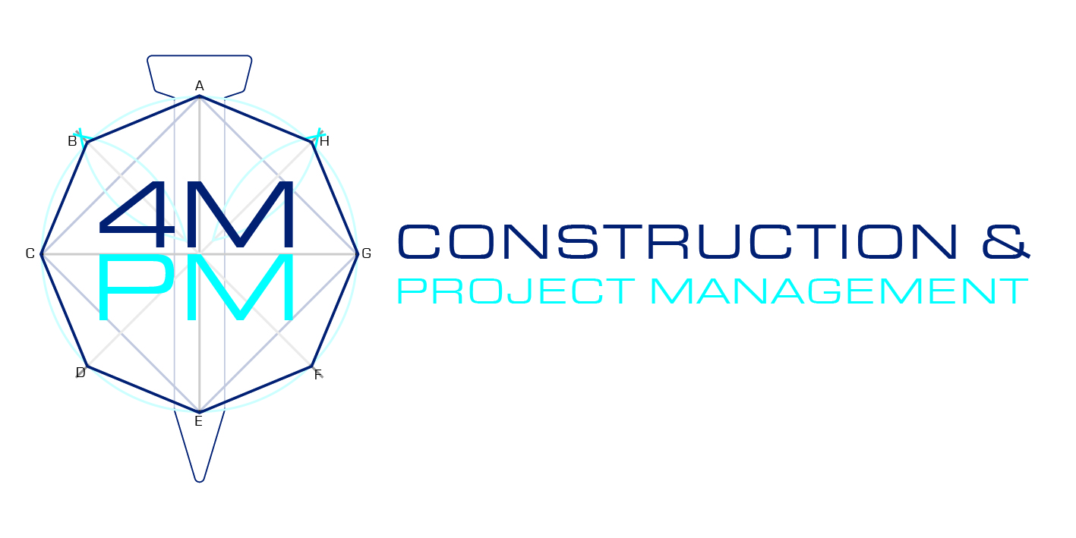

Slide 2
Contents
Contents
1
About Us
4
Our Services
2
Vision & Values
5
Our Projects
3
Mission Statement
6
Contact us

Slide 3
About us
4MPM Construction & Project Management was formally formed in 2018 as an independent construction consulting company. The firm offers complete transparency and stakeholder control over a wide variety of construction projects. We offer over 12 years of construction, architecture and civil engineering experience offering our clients a unique “project to contractor “ experience.

Slide 4
Vision & Values
Vision
“Vision 2030”is our vision to create an environment within the construction sector which will be based on integrity and good governance. Empowerment of previously disadvantaged , trustworthy SMME’s remains our ultimate priority.
Values
Transparency : We practice open communication and visibility within every project to attain a result which will be in the best interest of our clients, stakeholders and contractors.
Quality: Raising the bar of construction standards by implementing accountability within our team of subcontractors.
Empowerment: Our main priority is the empowerment of SMME’s and assisting with growth in this sector.

Slide 5
Mission Statement
To maintain the highest levels of professionalism, integrity, honesty and fairness in our relationships with our suppliers, subcontractors, professional associates and customers.

Slide 6
Our services
Project Management
Consulting
Construction
Complete management of your project from inception to completion. We offer risk analysis, project planning and close out on a variety of projects.
On and off site consulting on larger projects, which include procurement and monitoring of project management companies and specialist consultants.
Focusing on growth of SMME’s, we have offer long term property maintenance and portfolio management

Slide 7
Our projects

Slide 8
Our Projects
Client
Capacity
Project Value
Hamdani Investments
Principle Agent
R15 000 000-00
Bhamjee Residence
Principle Agent
R7 500 000-00
Recently Completed Projects
Pathan Residence
Principle Agent
R4 000 000-00
MAP Developments
Consultant
R5 400 000-00
Masingita Group
Consultant
R27 000 000-00

Slide 9
"Anyone can hold the helm when the sea is calm."

Slide 10
Contact us
50 Richmond Avenue
Auckland Park
Johannesburg, 2092
C: 084 567 8324
E: info@4mpm.co.za

